Slide 1

Team Approaching Winter
Game oF brushes

Slide 2
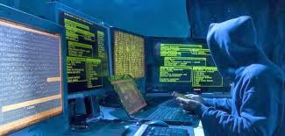

Team Approaching Winter
Михаил Гергинов (9б)
Петър Николов (9б)
Ангел Йорданов (9б)
Милен Илиев (9б)
Мартин Спасов (10г)

Slide 3



Developing technologies
C#(ASP.NET)
JavaScript

Slide 4





Game Of Brushes

Slide 5
Future ideas
Multiplayer
Leaderboard
Levels
Mobile and responsive design
Rotating screen
Lobby
Larger dictionary
Ranking system

Slide 6
Questions

